Slide 1
Sequential and Diverse Recommendation with Long Tail
Year : 2020
Conference : IJCAI
Author : Yejin Kim
Code : https://github.com/yejinjkim/seq-div-rec

Slide 2
Innovations
Cluster and relocate consumed long tail items to make a pseudo ground truth for diverse items and learn the preference on long tail using recurrent neural network.

Slide 3
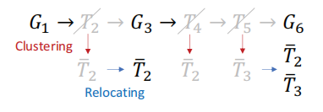
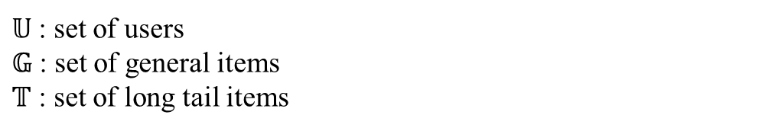


1、Pseudo Ground-truth Ranking Sequence
$𝕌$ : set of users
$𝔾$ : set of general items
$𝕋$ : set of long tail items
For a user $U∈𝕌$, its item history denoted as $(x_{1},x_{2},…,x_{J})$
Ranking scores $s_{j}=f(x_{1},x_{2},…,x_{J})$ or in short $s_{J}=f(x_{J})$
$\overline{T}∈\overline{𝕋}=\{\overline{T_{1}},\overline{T_{2}},…,\overline{T_{K}}\}$ : clusters of Kmeans
Raw
Rectified

Slide 4
2、Item content feature
Extract nouns from main text and title
Use the word2vec model to derive each word’s vector representation.
Aggregate all the word vectors in one text as a weighted sum of TF-IDF scores.
For the tail clusters, use a centroid of each cluster.
Word vector
Item content feature

Slide 5
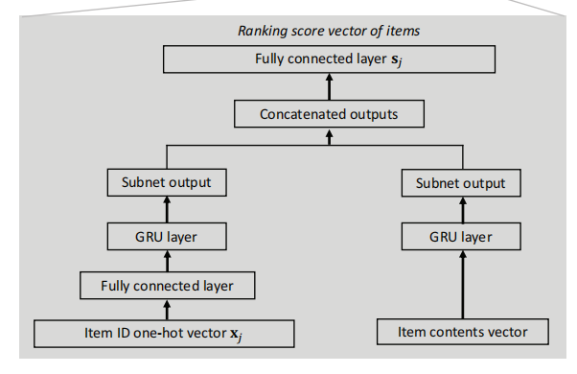

Slide 6


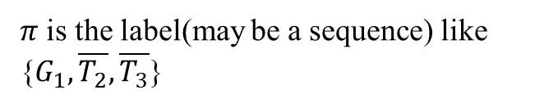
3、Loss Function
$π$ is the label(may be a sequence) like {$G_{1},\overline{T_{2}},\overline{T_{3}}$}
List-wise learning-to-rank approach ListMLE

Slide 7
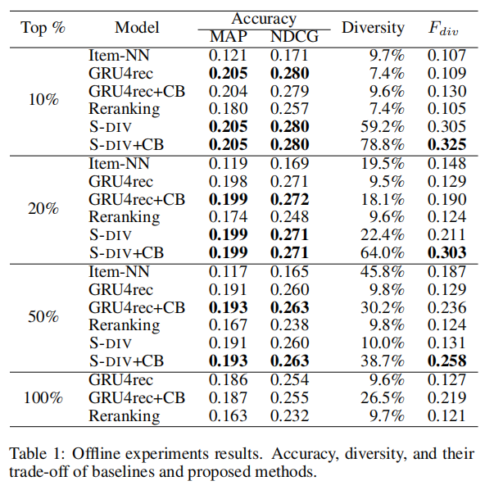
4、Experiments
Users’ historical logs on clicking blog articles from a commercial blog platform, Kakao (https://brunch.co.kr), which is one of largest blog platforms in South Korea with 4 million daily views.
Users and Items
2.2 million active users
263,016 articles
Length of sessions:
Max 796
Average 3.6

Slide 8
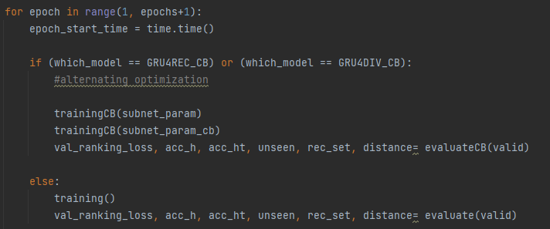
Questions
Alternating Optimization

Slide 9
2
3
1
4
5
1
4
3
0
0
[seq_len, batch, input_size]
3
5
0
0
0
2
3
1
4
5
1
4
3
[1, batch, input_size]
3
5

Slide 10
